Slide 1
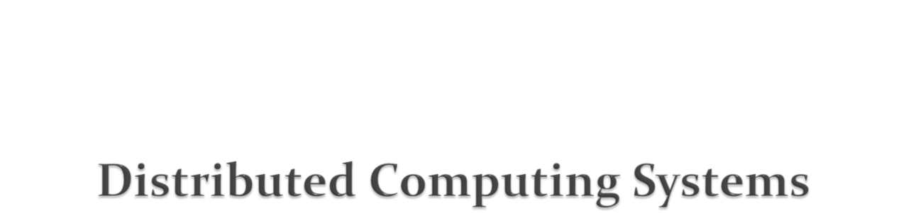
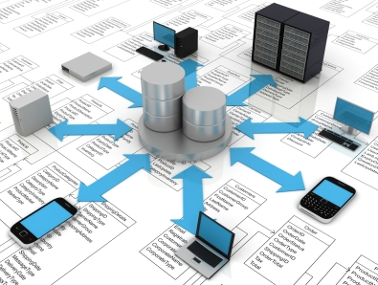
Dr. Sanjay P. Ahuja, Ph.D.
FIS Distinguished Professor of CIS
School of Computing
UNF

Slide 2
A distributed system is a collection of independent computers (nodes, sites) that appear to the users as a single system.
Each node of distributed computing system is equipped with a processor, a local memory, and interfaces.
Communication between any pair of nodes is realized only by message passing as no shared memory is available.
Usually, distributed systems are asynchronous, i.e., they do not use a common clock and do not impose any bounds on relative processor speeds or message transfer times.
These networked computers may be in the same room, same campus, same country, or in different continents.
Consequences of distributed systems:
Concurrency: In a distributed system, concurrent execution is the norm. E.g. a server may create two threads running concurrently to service two client requests.
Absence of a global clock: Programs cooperate not by any shared idea of time but by passing messages because there are limits to the accuracy with which computers in a network can synchronize their clocks. Thus there is no single global notion of time.
Independent failures: The components of a distributed system running on different computers can continue to execute independent of each other.
For e.g. the network can fail thus isolating clients and servers which continue to run. Or a server can crash and the client may still be up.
Notes:
An intranet is a portion of the Internet (composed of one or many LANs) that is separately administered by an organization (a company) to enforce local security policies.
An intranet is connected to the Internet via a router which allows users inside the intranet to use services such as the Web or email.
Companies want to protect themselves from malicious programs such as viruses or unauthorized users. Firewalls protect an intranet by preventing unauthorized messages from leaving or entering by filtering messages (e.g. on their source or destinations). E.g. might only allow emails and web accesses through.

Slide 3
The motivation for distributed systems stems from the need to share resources, hardware, software, and data.
Distributed System Goals
Resource Accessibility and Availability
Distribution Transparency
Openness
  Distributed systems should adhere to open standards that are publicly available and not proprietary. These standards ensure that different components of the system can communicate effectively without being tightly coupled to specific vendors or technologies.
Scalability
Dimensions that may scale:
  With respect to size
  With respect to geographical distribution
  With respect to the number of administrative organizations spanned
A scalable system still performs well as it scales up along any of the three dimensions
Notes:
An intranet is a portion of the Internet (composed of one or many LANs) that is separately administered by an organization (a company) to enforce local security policies.
An intranet is connected to the Internet via a router which allows users inside the intranet to use services such as the Web or email.
Companies want to protect themselves from malicious programs such as viruses or unauthorized users. Firewalls protect an intranet by preventing unauthorized messages from leaving or entering by filtering messages (e.g. on their source or destinations). E.g. might only allow emails and web accesses through.

Slide 4
The Internet is a very large distributed system that provides services such as the WWW, email, ftp, telnet, etc.
The set of services is open-ended in that it can extended by the addition of server computers and software components.
Notes:
An intranet is a portion of the Internet (composed of one or many LANs) that is separately administered by an organization (a company) to enforce local security policies.
An intranet is connected to the Internet via a router which allows users inside the intranet to use services such as the Web or email.
Companies want to protect themselves from malicious programs such as viruses or unauthorized users. Firewalls protect an intranet by preventing unauthorized messages from leaving or entering by filtering messages (e.g. on their source or destinations). E.g. might only allow emails and web accesses through.

Slide 5
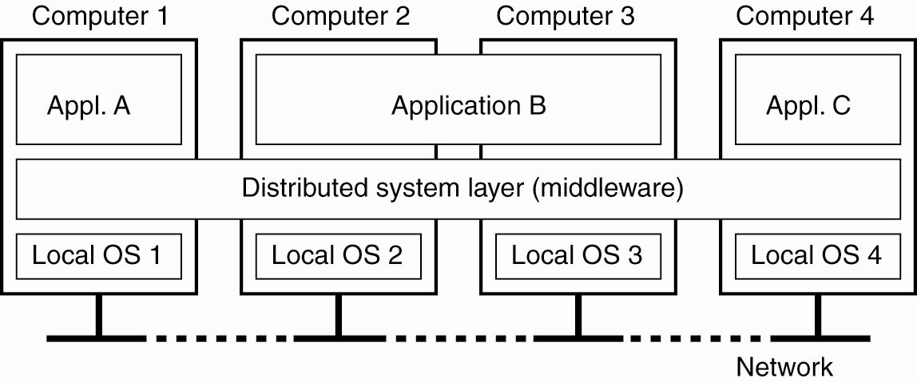

Slide 6
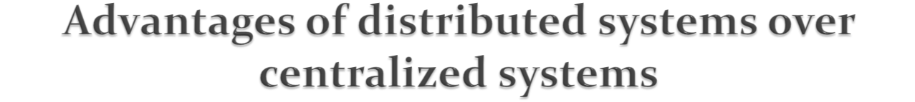
Economics
Computers harnessed together give a better price/performance ratio than mainframes.
Speed
A distributed system may have more total computing power than a mainframe.
Inherent distribution of applications
Some applications are inherently distributed. E.g., an ATM-banking application.
One design architecture can work or functioning at different nodes or locations.
Reliability
  If one machine crashes, the system as a whole can still survive if you have multiple
  server machines and multiple storage devices (redundancy).
Extensibility and Incremental Growth
Possible to gradually scale up (in terms of processing power and functionality) by adding more sources (both hardware and software). This can be done without disruption to the rest of the system.

Slide 7
Software:
difficult to develop software for distributed systems.
If the network underlying a distributed system saturates or goes down, then the distributed system will be effectively disabled thus negating most of the advantages of the distributed system.
Security is a major hazard since easy access to data means easy access to secret data as well.

Slide 8
Heterogeneity
The Internet comprises an heterogeneous collection of computers (hardware and operating systems), networks, programming languages, databases, implementations by different vendors etc.
Although the Internet comprises different networks, their differences are masked by the fact that all computers attached to these networks use the IP protocol (and TCP or UDP at the transport layer) to communicate with each other.
Data types such as integers may be represented in different ways on different computers. E.g. the byte-ordering (big-endian UNIX SPARC stations and little-endian WINTEL platforms).
The API to TCP/IP for different platform are different. E.g. the BSD Socket API for UNIX/SPARC platforms and Winsock API for WINTEL platforms.
Different programming languages have different representations for characters and other data structures.
Notes:
there are several APIs (Application Programming Interfaces) available in various programming languages. These APIs provide developers with the tools and functionalities needed to create, manage, and interact with TCP and UDP sockets

Slide 9
The term middleware refers to a software layer that provides a programming abstraction as well as masks the heterogeneity of the underlying networks, hardware, operating systems and programming languages.
Thus if an application developer uses middleware (such as RPC) then the developer does not need to know the network protocol details and the Socket API.
Both CORBA and Java RMI are examples of middleware. RMI is Java specific while CORBA is language-neutral.
Besides masking heterogeneity, middleware provides services to developers of distributed applications such as remote object invocation, remote SQL access, naming service, and distributed transaction processing.
Notes:
CORBA (Common Object Request Broker Architecture) is a standard defined by the Object Management Group (OMG) for creating distributed systems. It's a middleware that enables interoperability between distributed objects, allowing them to communicate with each other regardless of the programming language or platform they are implemented on.
E.g. CORBA and RMI provide for remote object invocation which allows for the invocation of a method of an object residing on another machine. This makes the invocation look as though it were a local invocation and the fact that a network and message passing are involved is masked.

Slide 10
The term mobile code refers to code that can be sent from one computer to another and run at the destination – Java applets are an example.
The concept of a virtual machine provides a way of making code executable on any hardware. The compiler generates code for a virtual machine rather than for a specific processor. E.g. the Java compiler generates code for the Java Virtual Machine (JVM).

Slide 11
2. Security
Security of information in distributed systems has three components:
  Confidentiality: protection against disclosure to unauthorized individuals.
  Integrity: protection against alteration or corruption.
  Availability: protection against interference or obstacles that prevents access to the resources.
  E.g. sending credit card numbers over the Internet in an E-commerce application.
  Security involves encryption and authentication.
  Two other security challenges include
  denial of service attacks and security of mobile code.

Slide 12
3. Scalability
A system is described as scalable if it will remain effective when there is a significant increase in the number of resources and users.
e.g. the Internet is one such distributed system.
Challenges in the designing of scalable distributed systems include:
a. Controlling the cost of physical resources.
For a system with n users to be scalable, the quantity/cost of physical resources to support them must be at most O(n), i.e., proportional to n. So if a single file server can support 20 users, 2 such servers should support 40 users.
b. Controlling the performance loss.
Algorithms that use hierarchic storage structures (e.g. LDAP) scale better than those that use linear (e.g. flat file data tables) structures. Even with hierarchic structures an increase in size (of data) will result in some performance loss since the time taken to access hierarchically structured data is O(log n), where n is the size of the data set.
c. Preventing software resources running out.
Lack of scalability is shown by the 32-bit IP addresses. The new version (IP v6) will use 128 bit addresses.
d. Avoiding performance bottlenecks.
Algorithms should be decentralized to avoid performance bottlenecks. E.g. the name table in DNS was originally kept in a single master file. This became a performance bottleneck. It was then partitioned between DNS servers located throughout the Internet and administered locally. Caching and replication can also improve performance of resources that are heavily used.

Slide 13
4. Failure Handling
Failures in distributed systems are partial – some components fail while others continue to function. Hence failure handling can be difficult. Techniques can be used to:
a. Detect failures: E.g. use checksums to detect corrupt data in a file/message. Other times failure can only be suspected (e.g. a remote server is down) but not detected and the challenge is to manage in the presence of such failures.
b. Mask Failures: Some failures that have been detected can be masked/hidden or made less severe. E.g. messages can be retransmitted when then fail to be acknowledged. This might not help if the network is severely congested and in this case even the retransmission may not get through before timeout. Another e.g. File data can be written to a pair of disks so that if one is corrupted, the other may still be correct (redundancy to achieve fault-tolerance).
c. Tolerate Failures: Most of the services on the Internet exhibit failures and it is not practical to detect or mask all the possible kinds of failures. In such cases, clients can be designed to tolerate failures. E.g. a web browser cannot reach a web server it does not make the user wait forever. It gives a message indicating that the server is unreachable and the user can try later.

Slide 14
4. Failure handling (contd.)
d. Recovery from failures: This involves the design of software so that the state of permanent data can be recovered or “rolled back” after a server has crashed. E.g. database servers have a transaction handling ability that enables them to roll back a transaction that was not completed.
e. Redundancy:
There should be at least two different routes between any two routers in the Internet.
In the DNS, every name table is replicated in at least two different servers.
A database may be replicated in several servers to ensure that the data remains accessible after the failure of a single server; the servers can be designed to detect faults in their peers; when a fault is detected in one server, clients are redirected to the remaining servers.
Distributed systems exhibit a high degree of availability in the face of hardware faults. The availability of a system is a measure of the proportion of time that it is available for use. E.g. if one server goes down, client requests can be directed to another server and the service continues to be available.

Slide 15
5. Concurrency
There is a possibility that several clients will attempt to access a shared resource at the same time. Servers in a distributed environment tend to be concurrent servers rather than iterative in order to increase throughput (clients serviced per sec). In many cases this involves having a new thread service each client request. It must be ensured that concurrent access to objects in a distributed application be safe by using appropriate synchronization techniques.
6. Transparency
This is defined as the concealment from the user of the separation of components in a distributed systems, so that the system is perceived as a whole rather than as a collection of independent components. There are many kinds of transparency:
Access transparency enables local and remote resources to be accessed using identical operations (e.g. RMI/RPC, NFS).
Location transparency enables resources to be accessed without knowledge of their location.
Concurrency transparency enables several processes to operate concurrently using shared resources without interference between them.
Reliability transparency enables multiple instances of resources to be used to increase reliability and performance without knowledge of the replicas by users or application programmers.
Notes:
Access and location transparency are the most important, and are collectively called network transparency. E.g. of access transparency is using the same API to access both local and remote files (NFS). An e.g. of lack of this is using FTP to access files.
Web URLs are location-transparent since the name refers to a computer domain name rather than an IP address.
An email address such as sahuja@unf.edu is an eg of network transparency since it provides both access (address of another person is of same structure whether local or remote) and location transparency (don’t know the other person’s physical or network location).

Slide 16
Transparency (contd.)
Failure transparency enables the concealment of faults, allowing users and application programs to complete their tasks despite the failure of hardware or software components.
Mobility transparency allows the movement of resources and clients within a system without affecting the operation of users or programs.
Performance transparency allows the system to be reconfigured to improve performance as loads vary.
Scaling transparency allows the system and applications to expand in scale without change to the structure or the application algorithms.
Notes:
Failure transparency is exhibited by email which keeps attempting to deliver mail so the faults are masked.
Cell phones exhibit mobility transparency since the caller and callee are not aware of the mobility of their phones.

